Slide 1
GeoXO Update
User Facing Communications
Daniel Gillies GEO Deputy Program Systems Engineer, NOAA
Joint GRB-HRIT/EMWIN
Users Group Meeting
October 24, 2023
For Public Release @ Joint GRB-HRIT/EMWIN Users Group Meeting

Slide 2
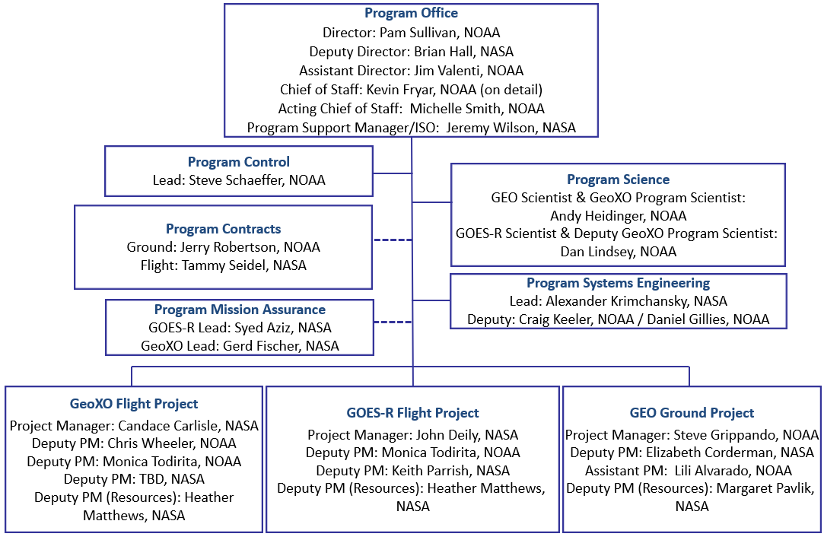
GEO Program Org Chart
GOES-R & GeoXO → GEO Program
Craig Keeler retiring later this year
Daniel Gillies (me) is new Deputy Program Systems Engineer
Focus Areas w/in GEO Program Office
Program Level 1 and Level 2 Requirements
User Facing Communications (UFC) Requirements
DCS
HRIT/EMWIN
GRB
Support GeoXO Data Distribution Studies & Implementation
Program Office RF Licensing Focal
Contact Info: daniel.gillies@noaa.gov

Slide 3
What is GeoXO?
GeoXO = Geostationary Extended Observations
GOES-R follow-on to provide continuity for geostationary environmental observations
Continues and improves observations for weather forecasting
Extends observations to ocean and atmospheric monitoring
Provides environmental data broadcast via commercial satellite services
NOAA-NASA Partnership
Series of six satellites, operated in a constellation of three:
East + West locations: Imager, Lightning Mapper, Ocean Color, DCS
Center location: IR Sounder, Atmospheric Composition
Key Milestones
Imager (March 2023) & Sounder (September 2023) Contracts Awarded
Spacecraft RFP Released (September 2023)
PDR: FY2025
CDR: FY2027
First Launch: FY2032

Slide 4
GeoXO Constellation
HRIT/EMWIN and GRB Direct Broadcast via Commercial Satellite Services
DCS data relay and 2-way commanding planned for GeoXO-West & East

Slide 5
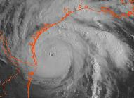
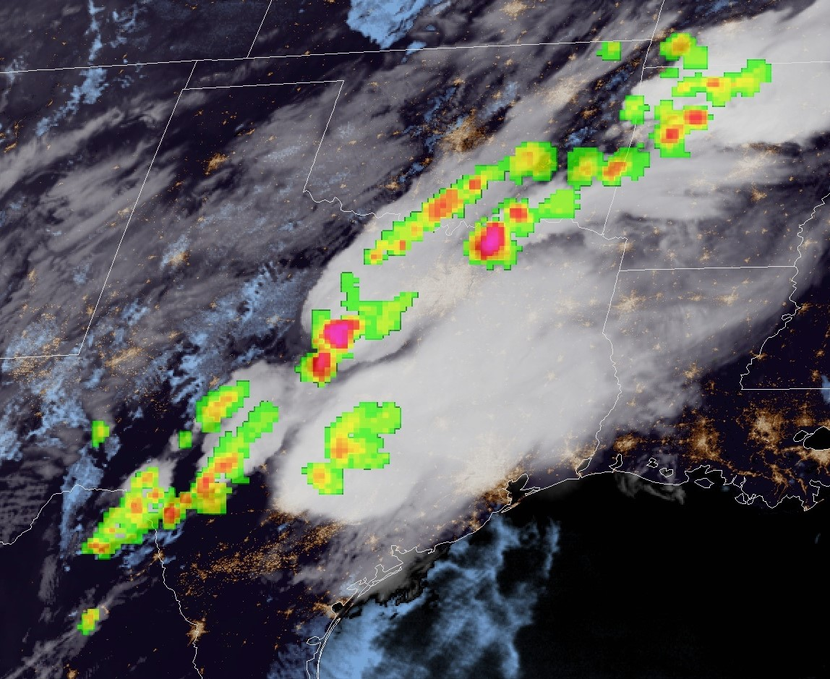
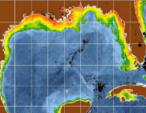
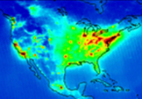
GeoXO Observations
GOES-R provides Visible/Infrared Imagery and Lightning data:
Essential for short-range forecasting, issuing severe weather watches and warnings, and monitoring hazardous environmental conditions including tropical storms, severe storms, damaging winds, snow, ice, flooding, fog, fires, smoke, and volcanic ash
GeoXO will continue and improve Imagery and Lightning data and add new observations:
Hyperspectral IR Sounder for numerical weather prediction and local nowcasting
Ocean Color Instrument for monitoring dynamic coast/ocean features, ecosystem change, water quality, and hazards
Atmospheric Composition Instrument for monitoring air quality and the linkage between air quality, weather, and climate
Vis/Near-IR Imagery
Lightning Mapping
IR Sounding
Ocean Color
Atmo. Composition

Slide 6
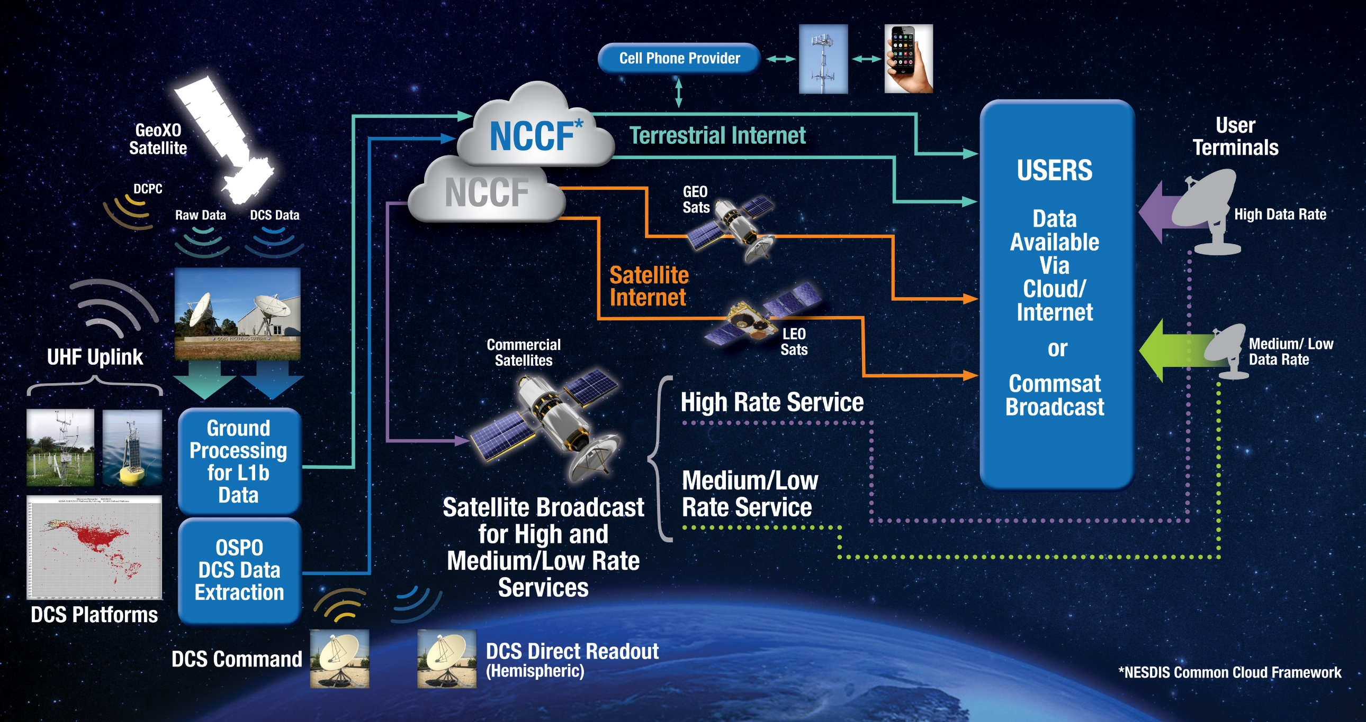
GeoXO Data Distribution
GeoXO Changes from GOES-R
GRB (GOES Rebroadcast) and HRIT (High Rate Information Transmission) Emergency Managers Weather Information Network services transition to cloud based distribution
GRB & HRIT rebroadcast services provided by commercial satellite operators
SAR services not included in GeoXO
DCS maintains same distribution support as GOES-R
The NESDIS Common Cloud Framework (NCCF) is the hub for all GeoXO instrument data & products → All L1b Data Delivered to NCCF

Slide 7
GeoXO UFC Basic Overview
The baseline is to provide an equivalent RF-based replacement to GOES-R HRIT/EMWIN and GRB services
Equivalent coverage, costs, and content (from GeoXO)
Users responsible for receive system costs (same as GOES-R)
The data supporting these services will be hosted in the Cloud
Cloud is the most direct form of user access (All GeoXO L1bs delivered to Cloud)
Currently conducting GRB cloud distribution tests with CIRA & CIMSS
HRIT/EMWIN will be replaced by the GeoXO Medium Rate Service: 1 Mbps
Exact bandwidth as determined by commercial contracts
GRB will be replaced by the GeoXO High Rate Service: ~ 30 Mbps (TBR)
Exact bandwidth as determined by commercial contracts

Slide 8
GOES-R vs. GeoXO Rebroadcast
GOES-R
DCS
Coverage: Hemispherical ≥ 5 Deg
L-Band - 1679.9 MHz & 1680.2 MHz
HRIT/EMWIN
Coverage: Hemispherical ≥ 5 Deg
L-Band - 1694.1 MHz
GRB
Coverage: Hemispherical ≥ 5 Deg
L-Band - 1686.6 MHz
GeoXO
DCS
Coverage: Hemispherical ≥ 5 Deg
L-Band – 1691.9 MHz & 1692.2 MHz
Medium / Low Rate Service
Cloud & Commercial Rebroadcast
Coverage equivalent to GOES-R
Band: TBD
High Rate Service
Cloud & Commercial Rebroadcast
Coverage equivalent to GOES-R
Band: TBD

Slide 9
GeoXO / Commercial Rebroadcast Schedule
FY
First Launch : 2032
I-1
I-2
GeoXO
User Engagement
User Feedback & Support
Requirements Development
UFC Commercial Rebroadcast
Market Research
Prototyping
Transition / GOES-R Phaseout
Cloud Delivery Development
Commercial Rebroadcast Schedule Provides Time to Monitor Commercial Market Developments and Opportunities

Slide 10
Thank you
For more information visit www.goes-r.gov
www.facebook.com/GOESRsatellite www.youtube.com/user/NOAASatellites twitter.com/NOAASatellites www.flickr.com/photos/noaasatellites

